Slide 1
Social Media Analysis for Situation Awareness during Crises (SMASAC)
WebConf’18

Slide 2
Introduction

Slide 3






Speakers
Grégoire Burel
Research associate and data scientist at the Knowledge Media Institute (Open University) involved in the COMRADES European project and the lead developer of the Crisis Event Extraction Service (CREES).
Mayank Kejriwal
Computer Scientist in the Information Integration group in the Information Sciences Institute (ISI) at the USC Viterbi School of Engineering and works on knowledge graph construction and information extraction for socially consequential domains.
Prashant Khare
PhD student at the Knowledge Media Institute (Open University). His research focuses on extracting knowledge from crowd-generated content in course of crisis/disaster situations.

Slide 4


Tutorial Outline / Repository
Start Time | Duration (min.) | Session Name | Description
9:00am | 30 | Introduction | Introduction to situation awareness and social media use during crises.
9:30am | 20 | Data Collection | Data collection and basic filtering.
9:50am | 30 | Entity Extraction | Presentations of tools and methods for extracting entities.
10:20am | 40 | Coffee Break | Coffee break and technical support.
11:00am | 30 | Categorisation | Automatic classification of documents.
11:30am | 30 | Event Extraction | -
12:00pm | 20 | Visualisation | Examples of some situation awareness platforms.
Slides and Code: http://github.com/evhart/smasac-tutorial

Slide 5

Crisis Situation
A crisis (from the Greek κρίσις - krisis; plural: "crises"; adjectival form: "critical") is any event that is going (or is expected) to lead to an unstable and dangerous situation affecting an individual, group, community, or whole society.
Responding to crises rapidly is critical as they can involve:
Personal injuries (death, trapping, missing, etc.)
Infrastructure damage (roads blocked, services, etc.)
Global issues (civil arrest, conflicts, etc.)
Services overload (availability and access of emergency services and to resources)
How do we better understand a crisis situation in order to act accordingly?

Slide 6
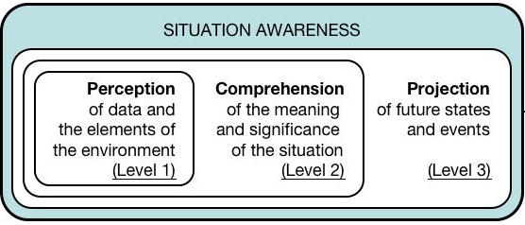
Situation Awareness (1)
Situation awareness is the perception of environmental elements and events with respect to time or space, the comprehension of their meaning, and the projection of their status.
Endsley's model of Situation Awareness (Endsley, 1995)
Information filtering, classification, entity extraction, etc.
Relation extraction, relevance, visualisation, etc.
Prediction models, time series analysis, etc.

Slide 7
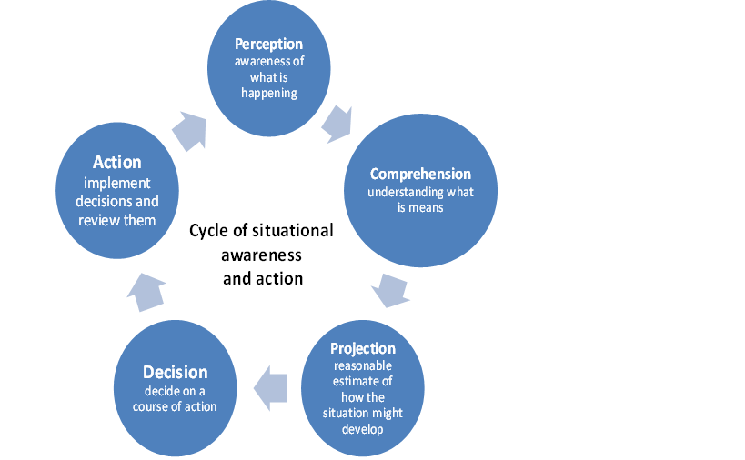
Situation Awareness (2)
Situation awareness is the perception of environmental elements and events with respect to time or space, the comprehension of their meaning, and the projection of their status.
Why do we need situation awareness during crises?
Accessible knowledge can be integrated to assess and cope with a situation (Sarter 1991).
Citizens and responders must be able to collect reliable information and build an understanding of the current situation and its evolution (Endsley, 1995).
Obtain accurate real-time and complete information about a particular crisis situation (Winerman, 2009).
How do we collect and process efficiently information during emergency situations?

Slide 8
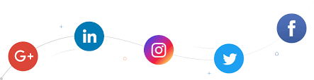
Social Media (1)
Social media consist of web technologies and platforms that enable people to interact and engage by creating content in a conversational and participatory manner
Social web applications are created to encourage communication between people, they tend to have some of the following attributes:
Identity: who are you? (e.g., Facebook)
Reputation: what do people think you stand for? (e.g. LinkedIn)
Presence: where are you? (e.g., Four Square)
Relationships: who are you connected with? who do you trust? (e.g., Facebook)
Groups: how do you organize your connections?
Conversations: what do you discuss with others? (e.g., Reddit).
Sharing: what content do you make available for others to interact with?

Slide 9
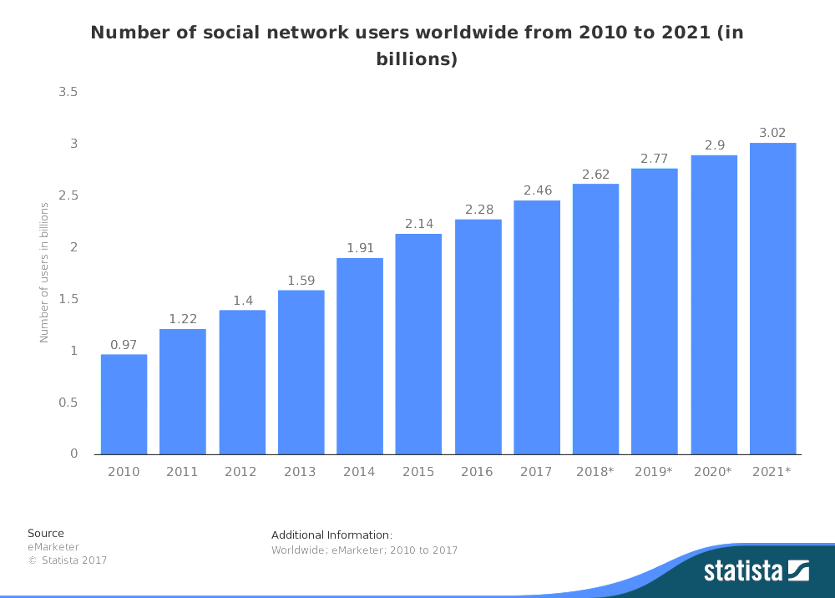
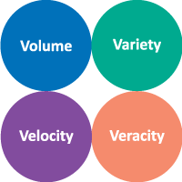
Social Media (2)

Slide 10








Social Media and Crises
Social media has become a common place for communities and organisations to communicate and share information during crises, to enhance their situational awareness, to share requests or offers for help and support, and to coordinate their recovery efforts.
Example of Twitter usage during crises (+200m active users / +400m posts a day):
During the 2011 Japan earthquake, 177 million tweets related to the event were sent in one day.
The news about the Boston bombings first appeared on Twitter.
How do we obtain situation awareness from noisy and large heterogeneous high-velocity real-time unstructured data?

Slide 11
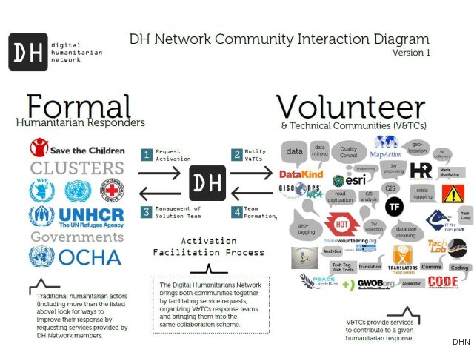
Digital Humanitarian Network et al.
With the emergence of social media and access to other technologies (e.g., mapping tools and information management platforms), digital volunteer networks have been created to help data processing tasks. Nevertheless, low-level tasks (e.g., data collection, information extraction and filtering) remain mostly manual labour.

Slide 12

Digital Situation Awareness Pipeline
When dealing with information collected from various online sources (e.g., SM, mapping software, etc.), it is necessary to be able to collect, represent, process and visualise such information in order to better understand a situation.
Collect
Analyse
Understand & Visualise
Act
Gather data from various information sources
Extract key information, verify trustworthiness, classify, etc.
Connect and Visualise information.
Decide what to do and organise actors and resources.

Slide 13
Typical (Manual) Processing Pipeline
During crises, most of the data is processed manually by crisis responders, digital humanitarian, organisations and individuals.
Collect
Search/browse social media website. Copy/paste in spreadsheet.
Analyse
Curation and Filtering
Classification
Entity Extraction
Manually select relevant posts during collection.
Annotate data / information priority, etc.
Understand & Visualise
Visualisation
Use visualisation applications (e.g., Ushahidi, OSM) or libraries.

Slide 14
Automatic Processing Pipeline
Supervised or semi-supervised methods as well as APIs an automatic tools can be used for collecting data.
Collect
Use API for collecting data.
Analyse
Curation and Filtering
Classification
Entity Extraction
Use event detection models for filtering documents.
Supervised / non-supervised classification models.
Named Entity Recognition and Entity Linking.
Understand & Visualise
Visualisation
Use visualisation applications (e.g., Ushahidi, OSM) or libraries.

Slide 15
Automatic Data Collection and Analysis
Collect
Data can be easily collected without requiring manual browsing:
Use streaming/search API for collecting data.
Typically restrict search using keywords and location.
Reformat data/extract basic information automatically for further processing (e.g., tokenisation, hashtags, URLs).
Store data in database (or save in a file).
Analyse
Curation and Filtering
Classification
Entity Extraction
Relevant data can be filtered automatically using keywords as well as event classifiers:
Use trained classifiers for identifying relevant documents and other relevant information.
Dynamically re-train classifiers.
Extract important information from documents (e.g., locations, actors, etc.):
Use Named Entity Recognition (NER) tools.

Slide 16
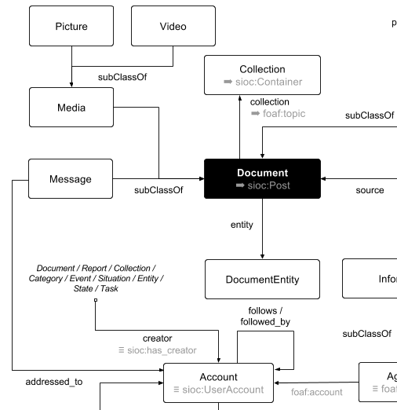


Data Visualisation
Understand & Visualise
Visualisation
Visualisation platforms or libraries can be used for visualising the processed data. For example, the following visualisation can be done:
Import data in situation awareness platforms (e.g., Ushahidi, Sahana).
Directly visualise the data using visualisation libraries (e.g., D3, Plotly, Bokeh, etc.)
Use HDX headers and Quick charts.
Use ontological visualisation platforms (e.g., Topica/WeKnowIt).
Typically, the firs step before visualisation would be to export the data in a common model or reformat the data according to the target platform:
CSV or CSV with HDX headers (HXL).
JSON format or custom format
Common ontology (e.g., CURIO, DoRES, etc.)

Slide 17




Hands-on Requirements

Slide 18




Software Requirements
Local installation
Local installation
(via Docker image
or repo2docker)
Remote execution
(via mybinder.org)

Slide 19













Demonstrated Tools and Libraries
Collect
Analyse
Understand & Visualise
TwitterNER

Slide 20

Used Data
The tutorial is focusing on Twitter data due the its availability. We use the CrisisLexT26 data since it is already made available. CrisisLex (http://crisislex.org/) is a repository of crisis-related social media data and tools. It includes collections of mostly Twitter crisis data and a lexicon of crisis terms.
The CrisisLexT26 dataset contains:
Tweets from 26 crises, labelled by informativeness, information type and source.
Data collected between 2012-2013.
~250K tweets (~28 000 annotated tweets).
Crises includes: Bombing, Building collapse, Crash, Derailment, Earthquake, Explosion, Fire, Floods, Haze, Shootings, Typhoon, Wildfire…

Slide 21
Tools/Workspace Configuration
Hands-on
or
Slides and Code: http://github.com/evhart/smasac-tutorial
Notes:
Stop here briefly for questions or small pause before moving on to the next substantive section

Slide 22
Data Collection and Filtering
Collect
Analyse
Understand & Visualise
Gather data from various information sources
Extract key information, verify trustworthiness, classify, etc.
Connect and Visualise information.

Slide 23
Social Media Usage during Crises
Social media usage during crises varies depending on:
Type of information shared (e.g., affected individuals, caution and advice, donation or volunteering, message of support, etc. ). [Olteanu et al, 2014]
Type of content shared (e.g., text, images, videos, links).
Content source (e.g., news organisation or journalist, eyewitness, government, NGO, company or for-profit organisation). [Olteanu et al, 2014]
Target audience (e.g., general public, other organisation, followers, friends/family).
Type of social media platform used (e.g., Facebook, Twitter, etc.)

Slide 24
Access to Social Media
Automatic access to social media data can be restricted in different ways:
Public / Non-public data: Most social media websites do not allow access to the information posted unless reading access is given explicitly by the information creator.
Query restrictions: Data access can be limited by API restrictions (e.g., rate limiting, query allowance).
Data Sampling: High velocity data is sometimes sampled by social media companies. As result, it is only possible to retrieve a portion of the relevant information.
Query Filtering: Often data is retrieved using query parameters (e.g., keywords, geolocation, etc.). Access to relevant data can be negatively impacted.

Slide 25
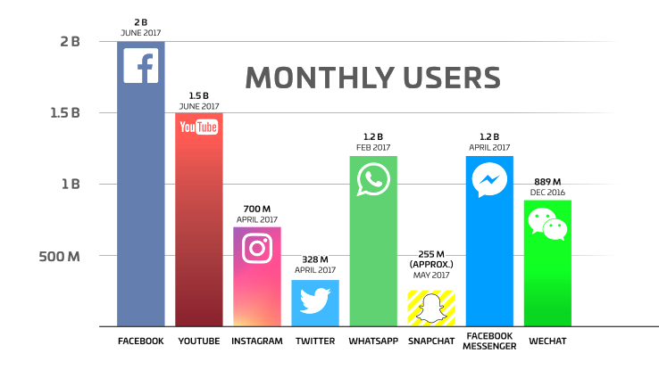
Most used Social Media Platforms
Source: https://techcrunch.com/2017/06/27/facebook-2-billion-users/
Notes:
Source: https://techcrunch.com/2017/06/27/facebook-2-billion-users/

Slide 26




Most used Social Media Platforms
 | Platform | API Access | Usage | Audience
 | Facebook | Low | High | Mostly Personal
 | YouTube | High | Medium | General
 | Instagram | High | - | Personal/General
 | Twitter | High | High | Mostly General
 | WhatsApp | NA | High | Personal
 | Snapchat | Low | - | Personal
 | Facebook Messenger | Low | - | Personal
 | WeChat | Low | - | Personal
Notes:
Discuss availability, api etc… for each

Slide 27
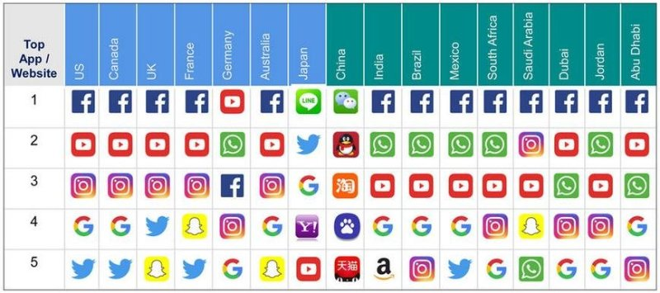
Worldwide Social Media App Usage
Notes:
Source https://techcrunch.com/2017/06/27/facebook-2-billion-users/

Slide 28
Data Collection/Processing Methods
Manual Methods
Go to social media website or solicit contributions.
Check for relevant content.
Copy/Paste content into spreadsheet.
Annotate spreadsheet.
Visualise the data.
Take action.
Automatic Methods
Use platform APIs
Perform query using the API (e.g., keyword search)
Automatically populate a database or spreadsheet.
Annotate manually or automatically the data.
Visualise the data
Take action

Slide 29
Data Collection/Processing Methods
Manual Methods
Go to social media website or solicit contributions.
Check for relevant content.
Copy/Paste content into spreadsheet.
Annotate spreadsheet.
Visualise the data.
Take action.
Automatic Methods
Use platform APIs
Perform query using the API (e.g., keyword search)
Automatically populate a database or spreadsheet.
Annotate manually or automatically the data.
Visualise the data
Take action

Slide 30

Automatic Data Collection APIs (Twitter)
Automatic data collection generally relies on JSON APIs and OAuth credentials. For example, for Twitter, you need to:
Create a Twitter account (https://twitter.com).
Obtain an OAuth access credentials (i.e., access token, access secret, consumer key and consumer secret) (https://apps.twitter.com/app/new).
Use Search API for collecting tweets (https://developer.twitter.com).
Save Tweets in JSON or other format for later analysis.
Example
$ gem install twurl
$ twurl authorize --consumer-key key \
--consumer-secret secret
$ twurl authorize --consumer-key key \
--consumer-secret secret
$ twurl "/1.1/search/tweets.json?q=earthquake“
{
"statuses": [
{
"created_at": "Mon Feb 12 10:58:42 +0000 2018",
"id": 963004430915289100,
"id_str": "963004430915289088",
"text": "RT @Independent: Magnitude 4.4 earthquake strikes near Beijing https://t.co/usygUyOkyA",
"truncated": false,
"entities": {
"hashtags": [],
"symbols": [],
"user_mentions": [
{
"screen_name": "Independent",
"name": "The Independent",
"id": 16973333,
"id_str": "16973333",
"indices": [
3,
15
]
}
],
"urls": [
{
"url": "https://t.co/usygUyOkyA",
"expanded_url": "http://www.independent.co.uk/news/world/asia/beijing-earthquake-latest-update-china-magnitude-hebei-tremors-capital-a8206336.html",
"display_url": "independent.co.uk/news/world/asi…",
"indices": [
63,
86
]
}
]
},

Slide 31
Automatic Data Collection on Twitter
Hands-on

Slide 32
Summary
Data collection can be done automatically using the APIs of different social media platforms.
Social media platform usage varies greatly across countries and demographics (e.g., target, information, etc.).
Access to social media data can be limited using APIs restrictions.

Slide 33
Data Curation (Filtering)
Collect
Analyse
Understand & Visualise
Gather data from various information sources
Extract key information, verify trustworthiness, classify, etc.
Connect and Visualise information.

Slide 34

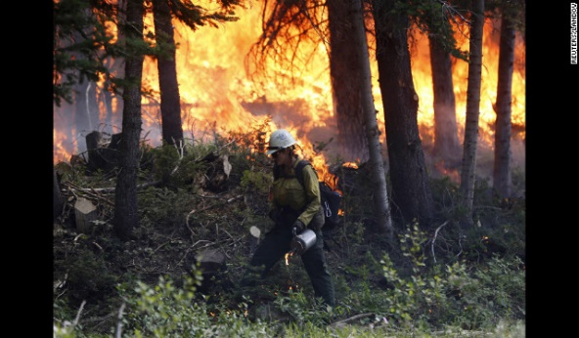
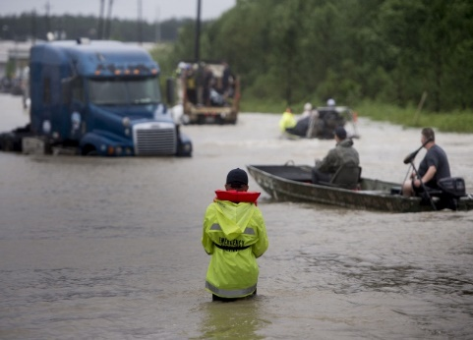
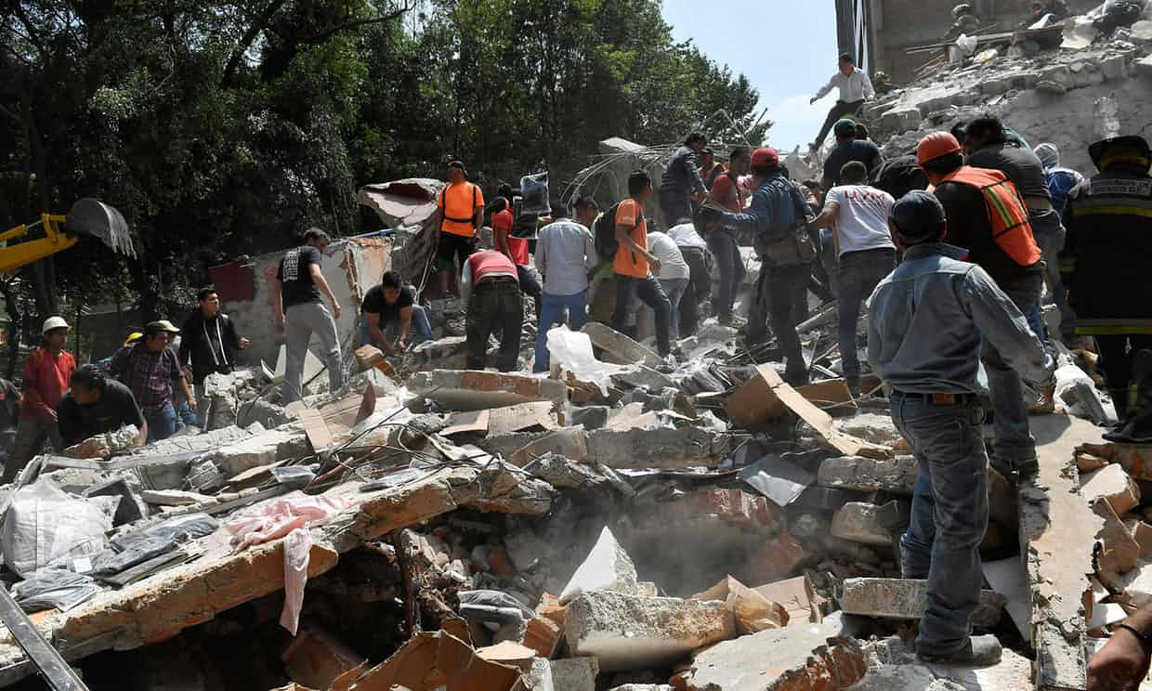
Twitter Data and Crises
People of NSW, be careful because there's fires spreading! Stay safe everyone!
Floods
CRISIS
Wildfire
Hundreds of volunteers in Mexico tried to unearth children they hoped were still alive beneath a school's ruins
Two trucks and one car in the water after a road collapse at Hwy 287 and Dillon. #cowx #boulderflood
Earthquake

Slide 35
Accessing Relevant Information
Information overload:
During crises, a flood of data gets generated. For example:
Over a million tweets generated during Hurricane Harvey 2017.
500% increase in the tweets bandwidth during 2011 Japan earthquake.
The characteristics of social media posts such as short length, colloquialism, syntactic issues pose additional challenges of processing the data.
Almost impossible to manually absorb and process the sheer volume.
How do we separate crisis-related content from irrelevant information?
How to ensure that a wide range of crisis related topics across diverse crisis situations are filtered in?

Slide 36
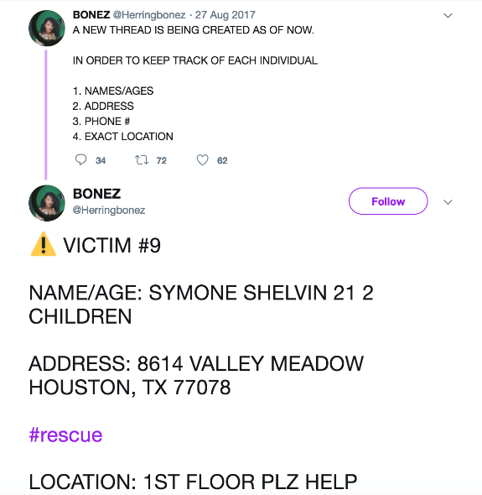


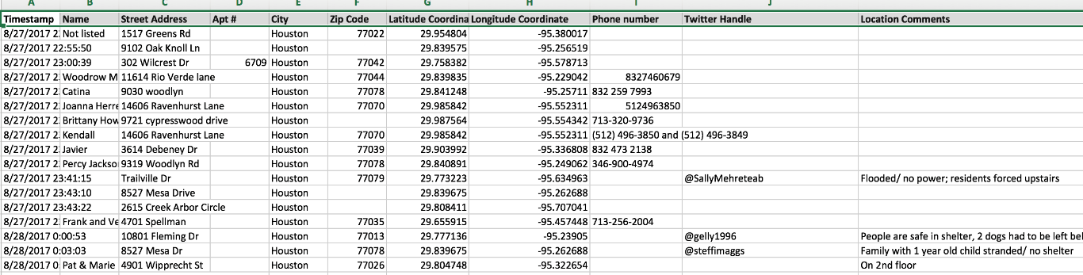
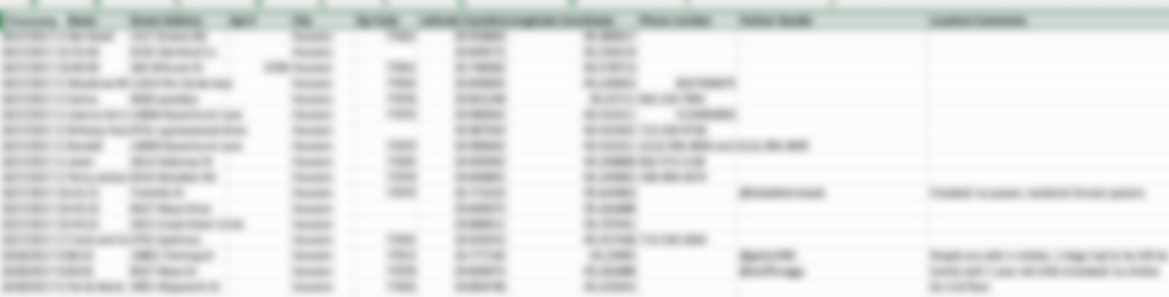
Hurricane Harvey – Data Collection/Filtering
Solicit
Information solicited on social media.
Collect and Enrich
Copy/Paste and manually extract information in spreadsheet.
Google Sheets

Slide 37

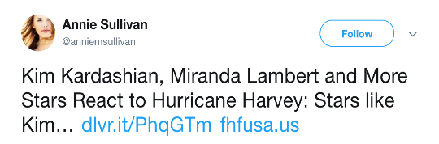
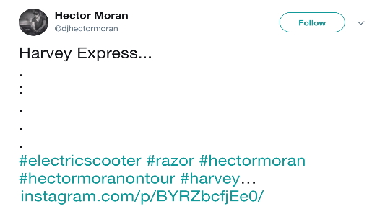
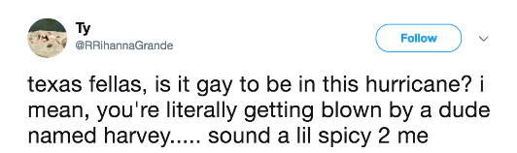
Data Curation (Filtering)
Content Curation:
Methods and processes used for gathering relevant information relevant to a particular topic of interest.
Information Filtering Systems:
Approaches for removing irrelevant and unwanted information from an information stream using partially-automated or computerized methods prior to presentation to a human user.

Slide 38
Filtering Methods
Use of hashtags, keywords, crisis specific phrases (impacted location name + canonical form of disaster name e.g. Hurricane Harvey)
Automated methods to search or classify:
semantic search,
machine learning based classification methods.

Slide 39
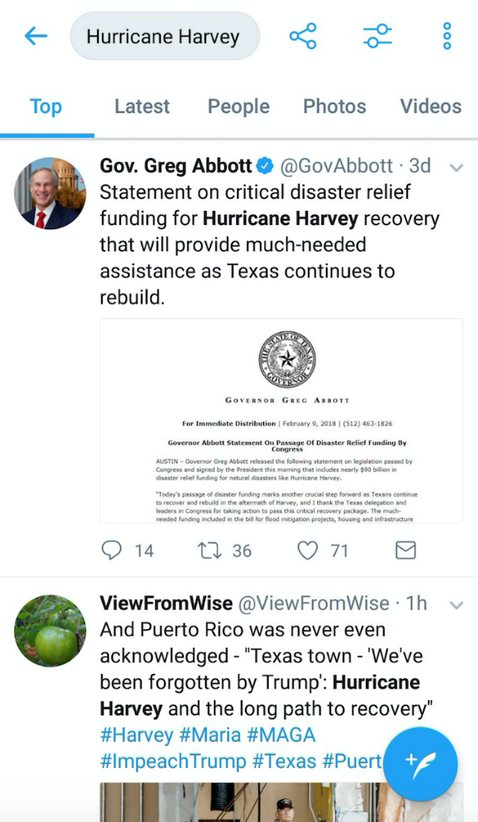
Use of HashTags, KeyWords, Phrases
Use Twitter Streaming/Search API
Twitter web search interface

Slide 40
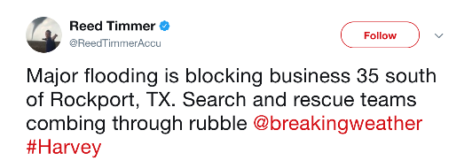
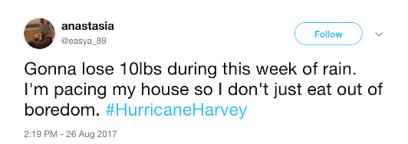
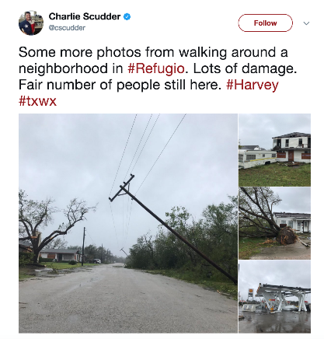
Limitations: Information Vs Noise
Relevant and Non-Relevant

Slide 41
What is the nature of the data?
HashTags, Keywords can be a convenient way to create a broad set of data, but they do not reflect the crisis related information.
The real crisis information is contained in a very diverse form.
The subjects in the information range from health/well-being of affected individuals, infrastructure, donations etc.
Obviously, various concepts together form a context which reflects relevance with the crisis situations.

Slide 42
Semantic Search

Slide 43
Semantic Search
Query based systems, where the relevancy of a tweet is established based on the context of a query.
Describe events as semantic queries and use knowledge graphs to map the data and the query.
Use of Natural Language Processing techniques and external Knowledge Graphs.
Can be tailored to a certain type of events or broad category of events.

Slide 44
Motivation
Complex event/information types are non-trivial to be described by single entity or keywords.
N-grams or bag of words do not directly contain semantic information.
Search for content based on a theme/context instead of precise information.

Slide 45
Approach
Consider a tweet T_{x} = t_{w}
Tweet is formed of words t_{w} = {w₁, w₂,… w_{n}}
Identify existing POS, entities, and concepts, and link to knowledge base such as Dbpedia or WordNet (via NLP and NER tools).
Resolve the tweet t_{w} as an n-tuple of concepts/properties.
For e.g. a quadruple (quad): subject, predicate, object, location or a collection of rdf:type of each extracted entity.
Resolve the query into semantically extended concepts from knowledge graphs.

Slide 46
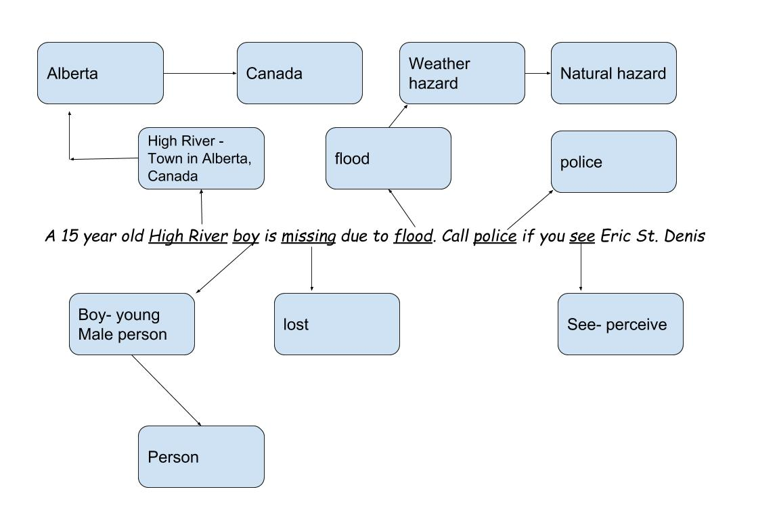
Example
Tweet : “A 15 year old High River boy is missing due to flood. Call police if you see Eric St. Denis”

Slide 47
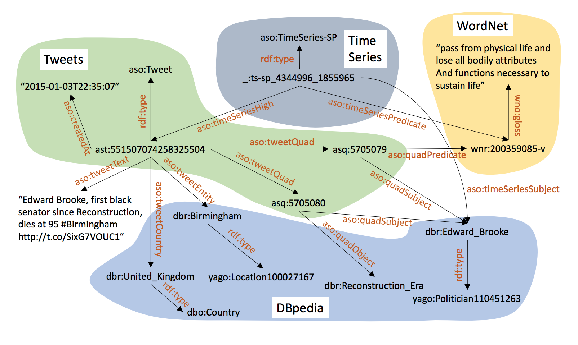
Graph Representation of Tweet
Source: Tonon, A., Cudré-Mauroux, P., Blarer, A., Lenders, V. and Motik, B., 2017, May. ArmaTweet: Detecting Events by Semantic Tweet Analysis. In European Semantic Web Conference (pp. 138-153). Springer, Cham.

Slide 48
n-Tuple form
{Tweet, Flood, Canada}
{Tweet, Flood, Alberta}
{Tweet, Flood, Lost, Person}
{Tweet, Lost, Person, Natural Hazard}
A tweet can be associated with multiple n-tuples.
- Schema : {Tweet, event type, location, participating entity}

Slide 49
Example Continued…
Query : “lost people in flood”
Semantic expansion of query:
Lost , missing , people, person, flood, natural hazard, weather hazard

Slide 50
Backend System
An indexing and search system such as Lucene/Solr.
A RDF database with uniquely defined properties for each tweet, such as subject, predicate, object, rdf:type, label, location etc.

Slide 51
Little about the knowledge graphs
A ‘graph’ — that understands real-world entities and their relationships to one another.
Another definition- A knowledge graph (i) mainly describes real world entities and their interrelations, organised in a graph, (ii) allows for potentially interrelating arbitrary entities with each other and (iv) covers various topical domains. [1]
1. Paulheim, H., 2017. Knowledge graph refinement: A survey of approaches and evaluation methods. Semantic web, 8(3), pp.489-508.

Slide 52
How are they created?
More often extracting information from Wikipedia, Wikidata, WordNet, GeoNames, VerbNet.
Wikipedia consists mainly free text with some structured information.
That includes: categories, info box, links to other entity pages, coordinates, title, abstract, relationships to other entities (people, organisation, location).

Slide 53
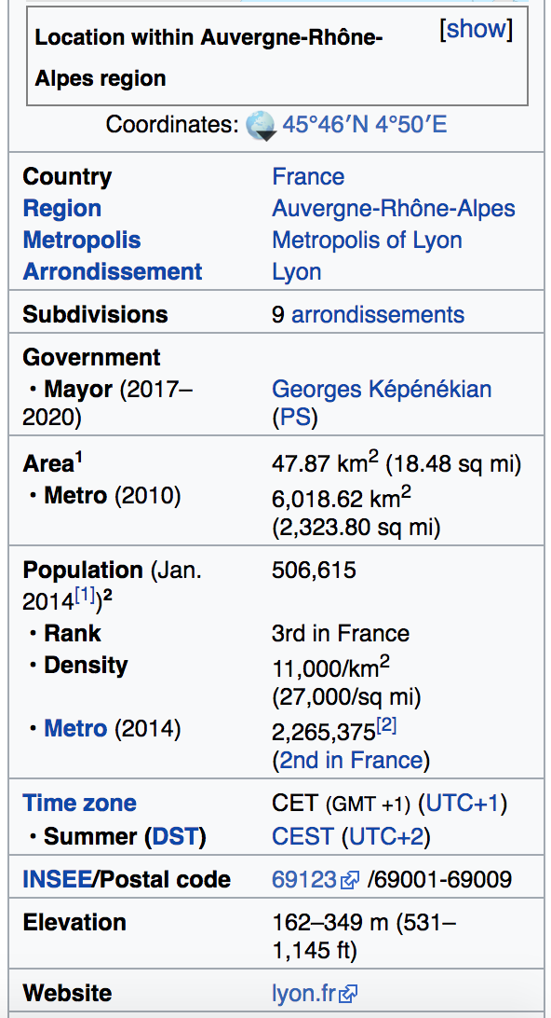
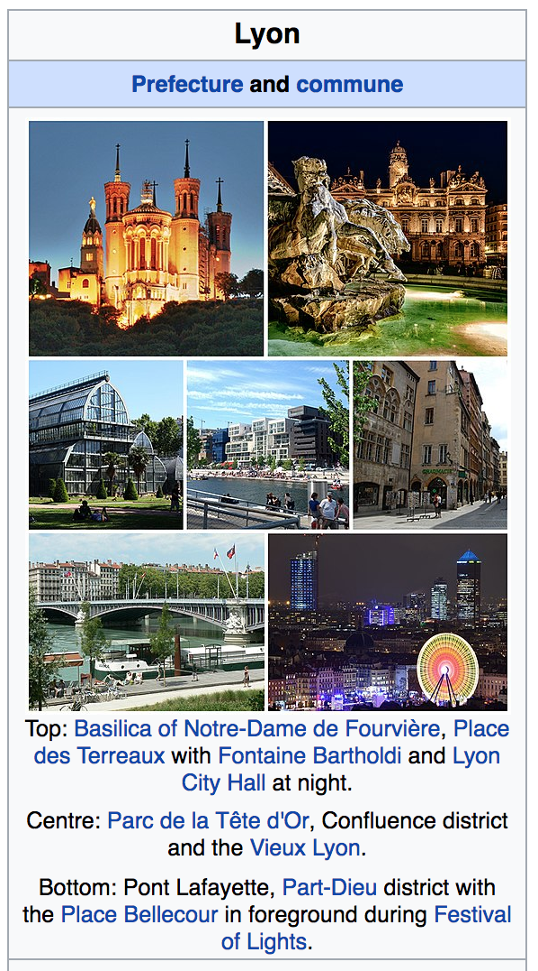
Structured Information-Wikipedia

Slide 54
Existing Knowledge base
Dbpedia
Google Knowledge Graph
BabelNet
YAGO
Wikidata

Slide 55





Entity Linking and Disambiguation APIs
Dbpedia Spotlight
Alchemy (IBM)
Babelfy (BabelNet)
Text Razor NLP API
Aylien Text Analysis API

Slide 56
Classification Methods

Slide 57
Machine Learning Classification Methods:
Supervised Approaches:
Often making use of n-grams, linguistic features, and/or statistical features of tweets.
Unsupervised Approaches:
Keyword processing and clustering.

Slide 58
Popular Machine Learning methods
Support Vector Machines.
Logistic Regression
Random Forest
Decision Trees
Deep Learning (Neural Networks: CNN, RNN, LSTM)

Slide 59
Incorporate semantics to n-grams and BOW
n-grams are the tokenized form of the original text of a document which are used as features.
Adding semantics to individual tokens can establish a consistency within crisis relevant information and enhance the discriminative power of classifiers.
Add statistical features to the feature set to inject various statistical properties of the text.

Slide 60
Statistical Feature
Text length
Number of words
Presence and count of various Parts of Speech
Data specific features such as HashTags (in tweets)
Readability Score (Gunning Fox Index using average sentence length (ASL) and percentage of complex words (PCW) : 0.4*(ASL + PCW))

Slide 61
Semantic Features
Co-occurring words (from a data corpus)
Extracted entities
Properties from knowledge graphs:
Type
Label
Subject
Same as
Contextual hierarchy – hypernyms, hyponyms, synonyms

Slide 62
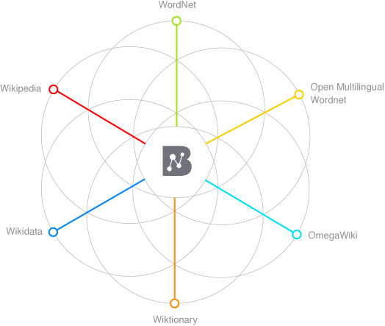
Semantic Enrichment Example
Lets us consider this Tweet from Colorado Wildfire 2012:
#HighParkFire
burn area map
as of
Monday night 10 p.m.
http://t.co/1guBTcXX
Annotated Tokens
Semantically enriched (augmented hypernyms)
burn
Burn destroy
area
area region map representation
map
Monday weekday
day_of_the_week night period
Monday
night
Image source: http://babelnet.org/about

Slide 63
Feature Representation
Text : “#HighParkFire burn area map as of Monday night 10 p.m. http://t.co/1guBTcXX”
Text Tokens: {highparkfire, burn, area, map, monday}
Semantic Tokens: {area, burn, fire, destroy, region, representation, day_of_the_week}
Combined document features = Text Tokens + Semantic Tokens
{highparkfire, burn, area, map, Monday, area, burn, fire, destroy, region, representation, day_of_the_week}

Slide 64
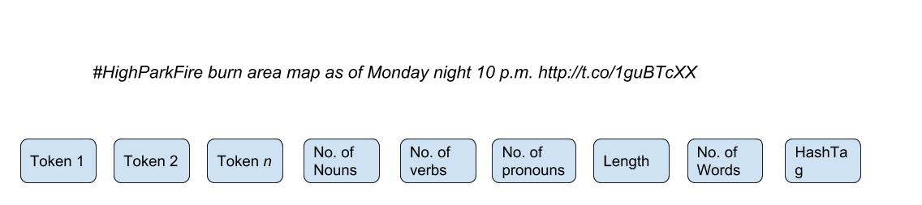
Feature Representation
Statistical Features:
Nouns = 6, verb = 0, pronoun= 0, length = 75, no. of words = 13, no. of hashtag = 1
Feature Set representation

Slide 65
Bottleneck!
How do you learn unless there is a data to learn from!

Slide 66
Data Sources
Labelled Social Data related to Crisis is available at-
CrisisLex
CrisisNLP
Crisis News Sympathy- https://github.com/abdoelali/CrisisNewsSympathy

Slide 67
CrisisLex Data
4 Categories of labels:
Related and Informative
Related and Not Informative
Not Related
Not Applicable
Converge to 2 labels for binary classification:
Related
Not Related

Slide 68
An Approach (can expand these points to individual slides)
Preprocess the tweets
Extract statistical features (Stanford Core NLP)
Perform Named Entity Recognition (IBM Alchemy, Babelfy) and extract semantics.
Merge the semantics with the original text (document)
Tokenise to generate n-grams
Pass the n-grams and statistical features to the Machine Learning Classifier

Slide 69
Preprocessing
The entire data can be redundant with duplicate tweets (often gathered in the stream as retweets)
Removing the duplicates gives the classifier a scope to learn from more variety of content.
Duplicate removal can be handled via removing tokens such as ’RT’,@user_handles, and special characters and then comparing the raw form of text of a tweet with other tweets (processed similarly).
Methods such as determining cosine similarity between texts and opting a threshold to select/discard can also be applied.

Slide 70
Extracting Statistical Features
As earlier mentioned the statistical features may comprise of linguistic attributes and other morphological attributes such a length and number of words etc.
To determine the linguistic parameters such as occurrence of various POS tags, it is important to know the language of the text (tweet).
Language detecting libraries- detectlanguage, langdetect, TextBlob.
Extract POS using NLP tools such as spaCy, Stanford CoreNLP etc.

Slide 71
Extracting Semantics
Use entity recognizing and entity linking APIs to extract entities.
Determine Dbpedia URIs+properties/BabelNet Sense/Hypernyms to extend the semantics.
Concatenate text + semantics.
Generate n-grams and pass on to binary classifier alongside statistical features to learn.

Slide 72
Coffee Break
Technical support during the coffee break…
or
Slides and Code: http://github.com/evhart/smasac-tutorial

Slide 73
Event Detection and Extraction
Collect
Analyse
Understand & Visualise
Gather data from various information sources
Extract key information, verify trustworthiness, classify, etc.
Connect and Visualise information.

Slide 74
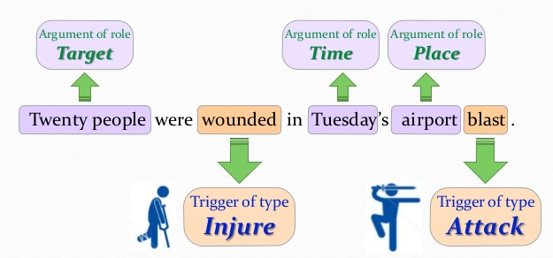
Simple Motivating Example

Slide 75
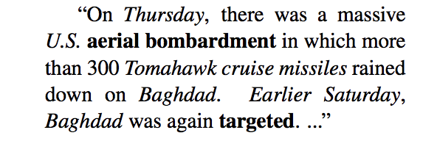
(More Complex) Motivating Example
Entities and spatio-temporal info are italicized
Event 1 anchor
Event 2 anchor
Event 1 provides context for Event 2

Slide 76
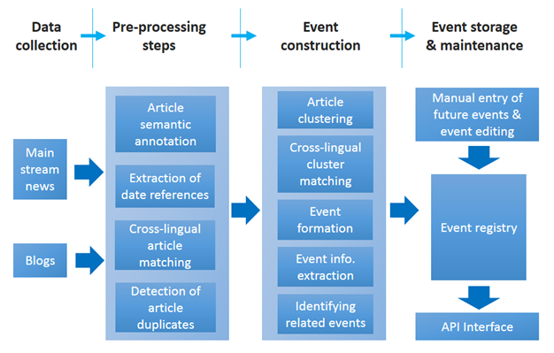
An Example Workflow

Slide 77
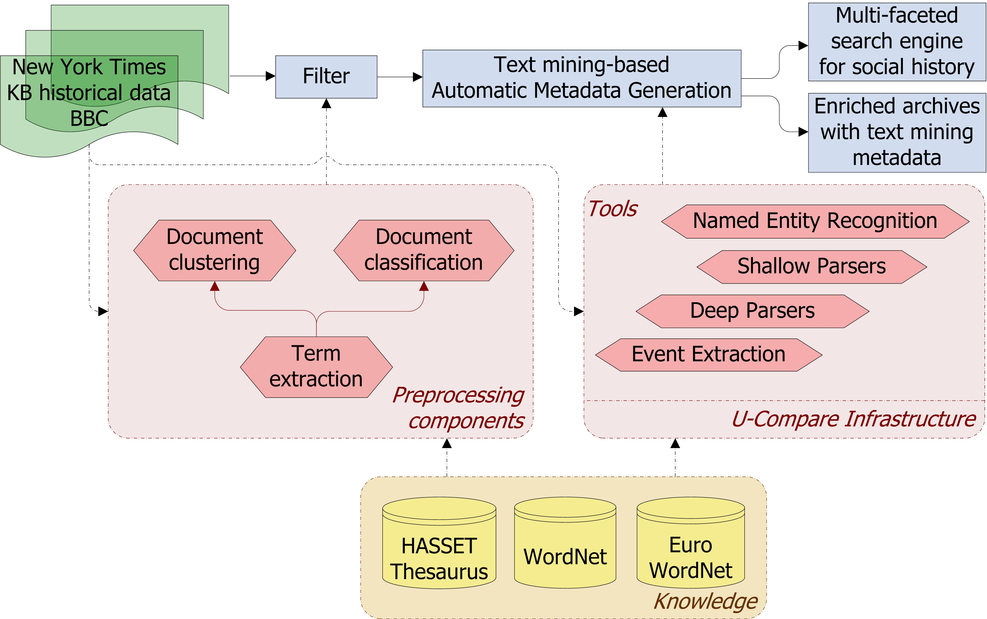
A Second Workflow

Slide 78
Classification of Techniques
Data-driven event extraction
Supervised machine learning models
Clustering
Inference models
Drawbacks?
Knowledge-driven event extraction
Lexico-syntactic patterns
Domain expertise
Knowledge bases
Drawbacks?
Hybrid systems

Slide 79
Hands-on
(Presently, could change) Yang and Mitchell’s work on joint event-entity extraction

Slide 80
Open Research Issues
Context-based advantages of data-driven, knowledge-driven or hybrid approaches
Understanding the limitations of specific event extraction techniques
The domain-dependency of event extraction procedures, affecting both their flexibility and effectiveness
The scalability of event extraction approaches when dealing with Big Data
The complexity of extracted events
Extraction from noisy sources like Twitter

Slide 81
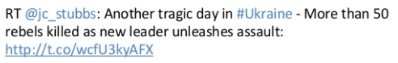
Event Detection in Twitter: Examples
RT @Stump4TrumpPAC: These are the 58 people killed in the Las Vegas massacre, the deadliest mass shooting in modern U.S. history.. 💐🙏🏻 http…
RT @dragoner_JP: うげえ……「ラスベガス銃撃の(カナダ人)犠牲者が巨額の医療費に直面」→ Las Vegas shooting victims facing large medical bills https://t.co/1F3bgH17Jv

Slide 82
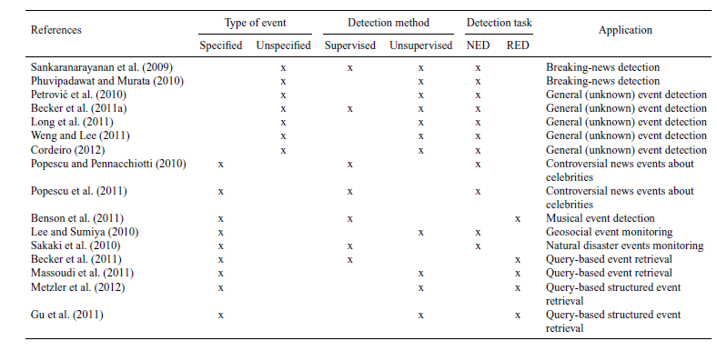
Event Detection in Twitter: A Taxonomy of Techniques

Slide 83
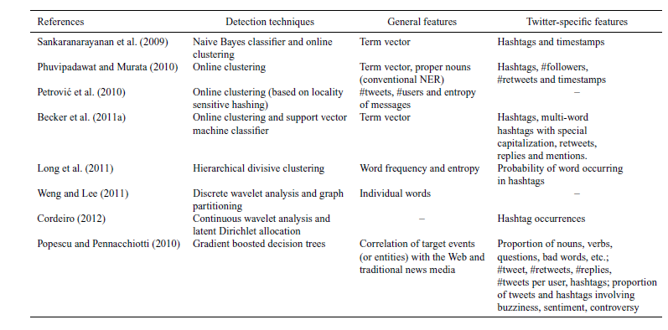
Detection Techniques and Feature Representation

Slide 84
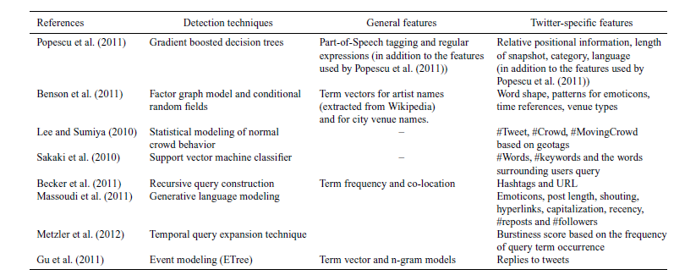
Cont’d

Slide 85
Hands-on
Event extraction system specifically designed for short texts/tweets

Slide 86
Open Research Issues
Better feature extraction and query generation techniques
More accurate filtering
Improved techniques to combine and analyze information from multiple sources and languages
Enhanced summarization and visualization
Non-static and non-stationarity assumptions
More principled and robust evaluations

Slide 87
Entity Extraction from Social Media
Collect
Analyse
Understand & Visualise
Gather data from various information sources
Extract key information, verify trustworthiness, classify, etc.
Connect and Visualise information.

Slide 88
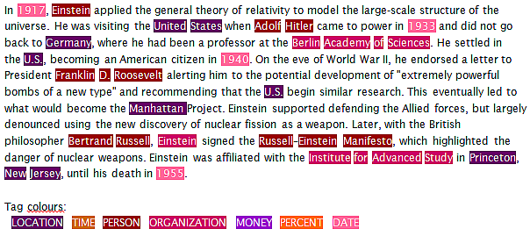
Entity Extraction aka Named Entity Recognition (NER)
NER is a classic problem in the Natural Language Processing (NLP) literature
Decades of research, with recent methods including deep learning and zero-shot learning
(Nadeau and Sakine, 2007)

Slide 89
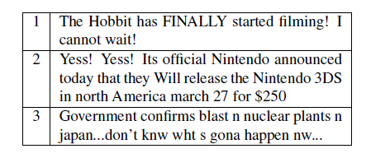
Entity Extraction aka Named Entity Recognition (NER)
NER is a classic problem in the Natural Language Processing (NLP) literature
Decades of research, with recent methods including deep learning and zero-shot learning
Social media involves some unique challenges for NER due to irregular text
(Ritter et al., 2011)

Slide 90
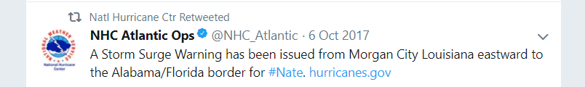
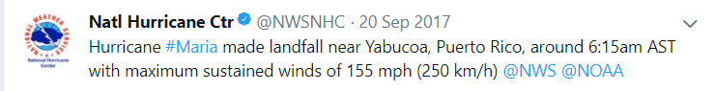
Relevance to Crisis Informatics
Many named entities mentioned in tweets and other social media

Slide 91
Relevance to Crisis Informatics
Many named entities mentioned in tweets and other social media
Extracting such entities (and also relations) enables us to pose interesting queries
What locations have received ‘Storm Surge Warnings’ from the NHC in the last 10 days?
What organizations were involved in relief efforts for Hurricane Irma?

Slide 92
Relevance to Crisis Informatics
Many named entities mentioned in tweets and other social media
Extracting such entities (and also relations) enables us to pose interesting queries
Interesting research question: what is an entity?

Slide 93
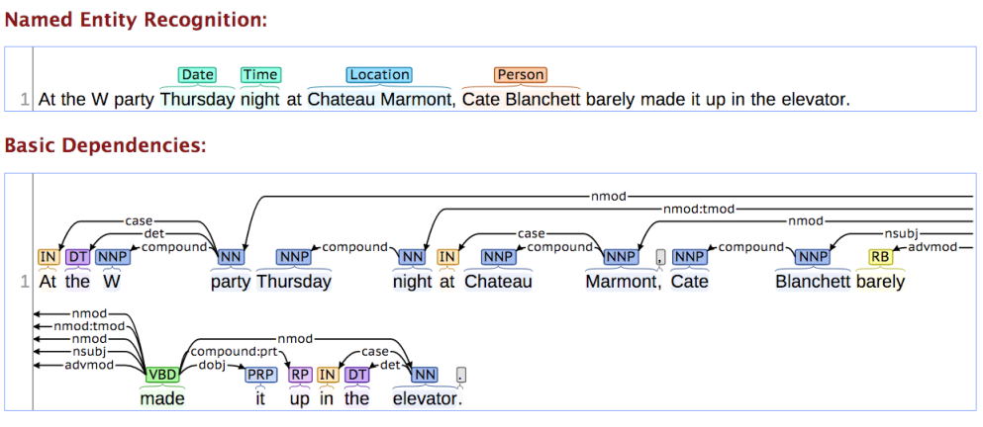
Typical NER Approach
Till recently, most models framed the problem as ‘sequence labeling’ using techniques like Conditional Random Fields and (earlier) Hidden Markov Models
(Lafferty et al., 2001)

Slide 94
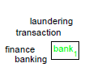
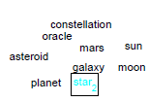
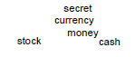
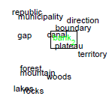
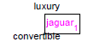
Embedding-based Models
Feature engineering was an impediment to training robust and powerful CRFs
Recently, word embeddings (and more complex sense-aware variants) have been used to address the problem

Slide 95





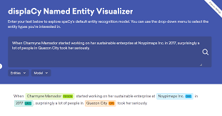
Powerful Tools and Packages Available

Slide 96
Powerful Tools and Packages Available
Demonstration of SpaCy

Slide 97
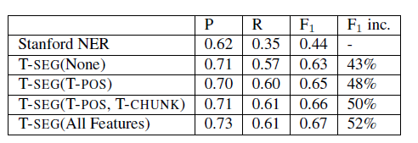
Observation: Off-the-shelf NER is Inadequate for Social Media
Example: Stanford NER (off-the-shelf) vs. T-SEG (a Twitter-specific NER tool)
P, R and F1 below stand for Precision, Recall and F1-Measure resp.
(Ritter et al., 2011)

Slide 98
Observation: Off-the-shelf NER is Inadequate for Social Media
Example: Stanford NER (off-the-shelf) vs. T-SEG (a Twitter-specific NER tool)
P, R and F1 below stand for Precision, Recall and F1-Measure resp.
Training Twitter-specific models and using Twitter-specific features offers significant performance advantages
(Ritter et al., 2011)

Slide 99
Twitter-specific NER Systems
Common Themes
Impact
Best systems maximize ‘signal’ by leveraging joint contexts, distributional similarity, word embeddings and even URLs
Geotagging tweets has emerged as its own ‘mini-area’ of research in the KDD, SW and WWW communities
Performance is improving slowly, albeit still far from performance on traditional inputs like newswire
Social-media specific NLP packages have emerged e.g., ArkNLP, T-SEG; workshops, shared competitions etc.
Lots of research into how to parse irregular text, NLP methods have arguably become more robust as a result
Spurred research on joint models, cross-domain entity linking

Slide 100
Classic System: T-SEG
First system to (arguably) show that Twitter-specific NER far outperforms off-the-shelf state-of-the-art NERs
Standard features (e.g., POS tags), with some optimized for Twitter
Twitter-specific features include new tags for hashtags, retweets etc.
Showed results earlier
In-domain training data (i.e. actual tweets)
Also used IRC chat data to supplement small training data
Used distributional similarity to account for spelling variations, predated similar ‘word embedding’ techniques like fastText by many years (conceptually)!
Clusters words like ‘tomarrow’, ‘tomm’, ‘tommarow’, ‘tommarrow’
(Ritter et al., 2011)

Slide 101
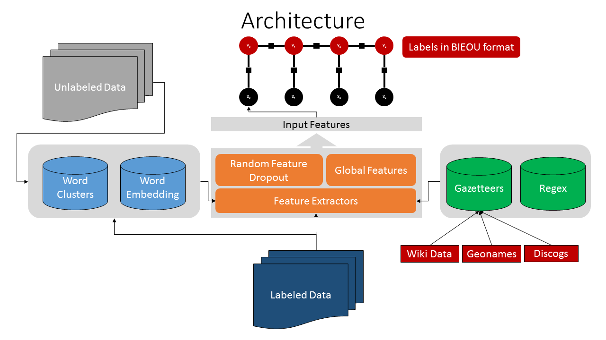
More Recent: TwitterNER
(Mishra and Diesner, 2013)

Slide 102
ArkNLP
Social-media specific NLP packages have emerged e.g., ArkNLP
Lots of research into how to parse irregular text, NLP methods have arguably become more robust as a result
Spurred research on joint models, cross-domain entity linking
Performance is improving slowly, albeit still far from performance on traditional inputs like newswire
Demonstration of TwitterNER

Slide 103
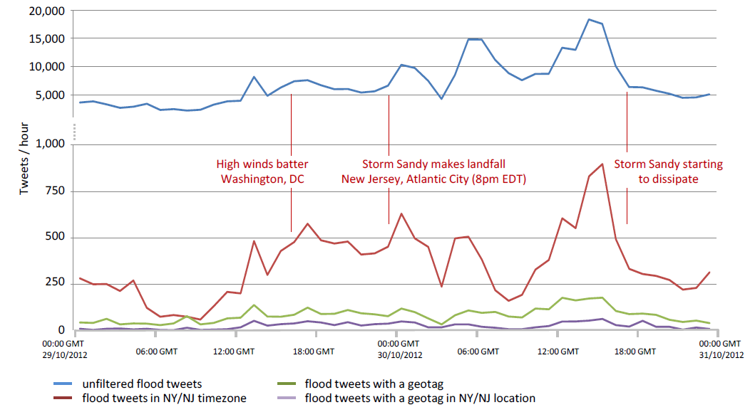
How to improve performance even further?
Models can be made more precise by treating each entity type (such as locations) individually i.e. train type-specific models
In some instances, entities can be ‘extracted’ despite not being explicitly present in the text (e.g., geotagging)
(Middleton, Middleton and Modafferi, 2014)

Slide 104

Example of crisis domain-specific geotagging system
Examples of domain-specific components
(Middleton, Middleton and Modafferi, 2014)

Slide 105
Open Research Issues
Accuracy still low for social media (SM) NER, how to improve performance without increasing training annotations?
How to work directly with noisy inputs (e.g., machine translated texts) and consume noisy NER outputs?
NER for cross-domain and multi-lingual/non-English SM
Chinese social media (He and Sun, AAAI’17)
How to leverage external contexts such as URLs in tweets, images, multi-modal signals, entity linking to sources like DBpedia...?
Can significantly enhance the ‘signal’ in the data e.g., see (Gattani et al., VLDB’13)
How to combine NER and event identification/extraction models by leveraging joint context?
Promising work in this area e.g., (Vavliakis et al., DKE, 13)
Novel applications and interfaces for crisis informatics pipelines

Slide 106
Visualizations and End-to-End Systems
Collect
Analyse
Understand & Visualise
Gather data from various information sources
Extract key information, verify trustworthiness, classify, etc.
Connect and Visualise information.

Slide 108
Review and Wrap-up

Slide 110
References

